Slide 1

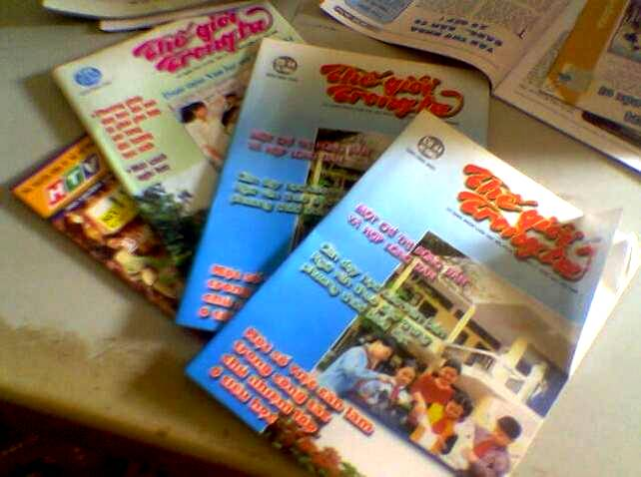
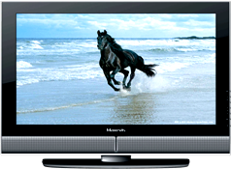
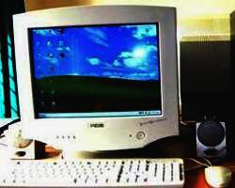

radio
Saturday, November 16th ,2019
THE MEDIA
magazines
computer
internet
television

Slide 2
Unit 5: Media
Getting Stared – Listen and Read

Slide 3
01.
Getting Stared

Slide 4
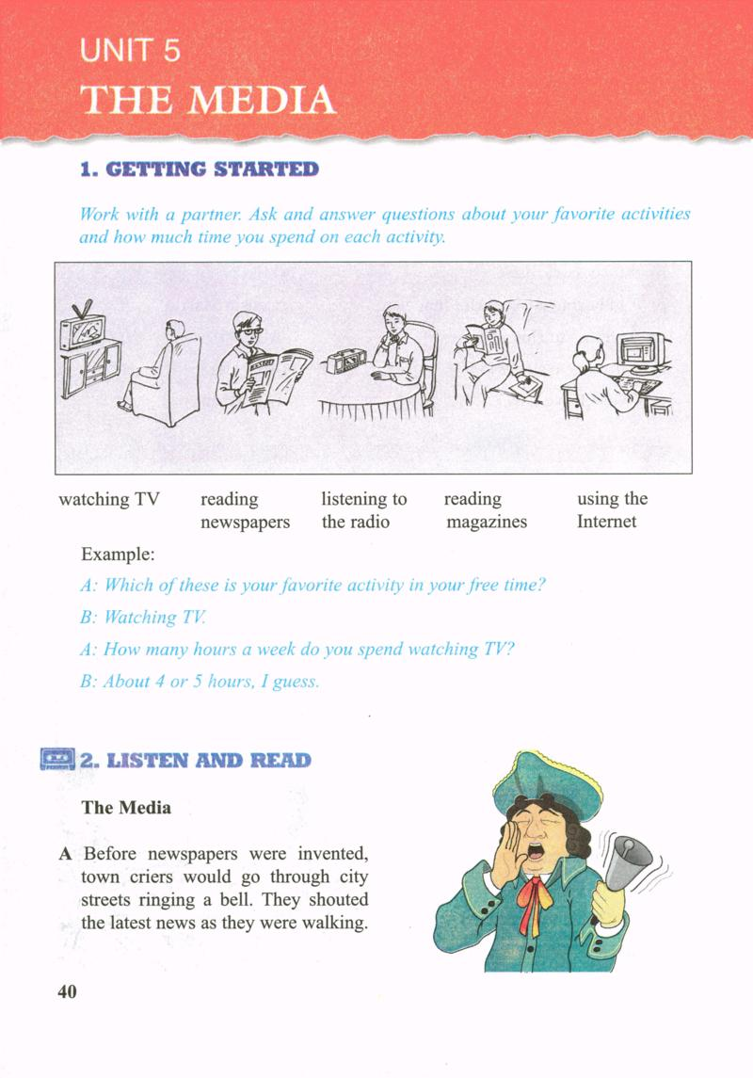
Matching :
1
2
3
4
5
Watching TV
Listening to radio
Reading magazines
Reading newspapers
Using the internet

Slide 5
Work in pairs:
Ask and answer about your favorite activities and how much time you spend on each one.
Watching TV
Reading newspapers
Listening to radio
Reading magazines
Using the internet
e.g.:
A: Which of these is your favourite activity in your free time?
B: Reading newspapers.
A: How many hours a week do you spend reading newspapers?
B: About 4 or 5 hours, I guess.

Slide 6
01
Listen and Read

Slide 7
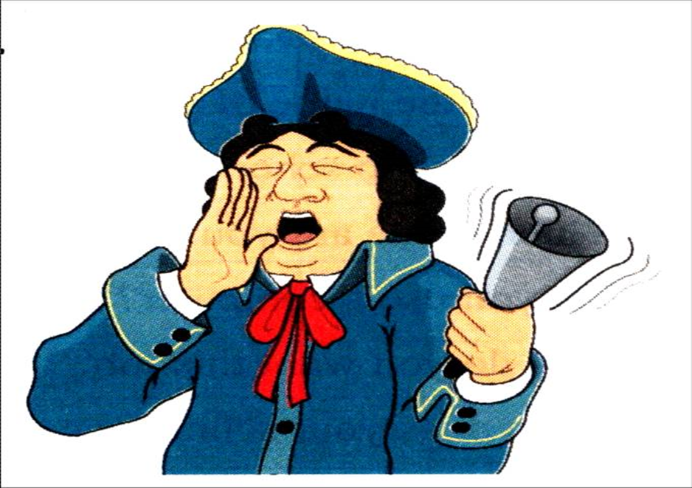

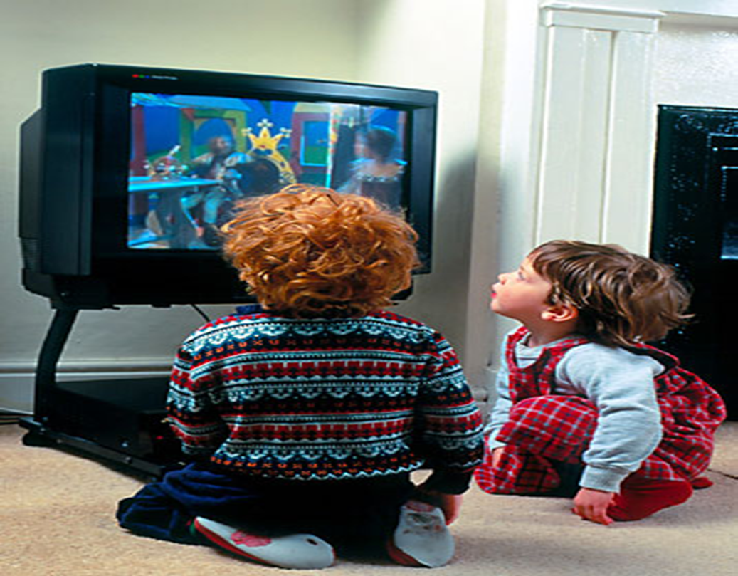
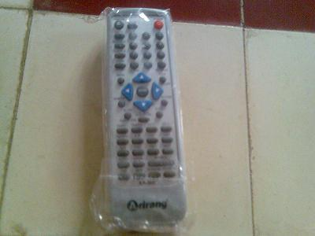
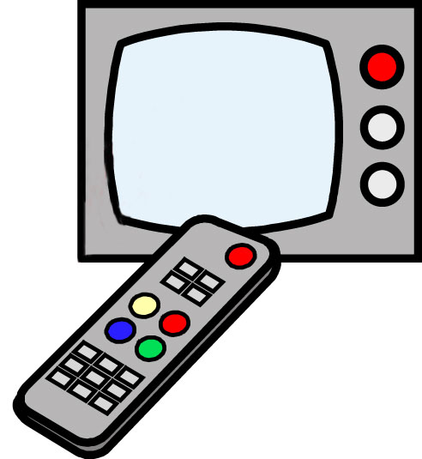
II. LISTEN AND READ
I. Vocabulary :
- a town crier (n) :
- viewers (n):
- a channel (n) :
- a remote control (n):
- interact (v):
- interactive (adj):
Ex: HTV2 is a channel of HTV.
- benefit (n):

Slide 8

Listen to the passages A,B,C and D.
Then answer what each passage is about.
PASSAGE | TOPIC
A
B
C
D
criers
newspapers and magazines
television
interactive TV

Slide 9
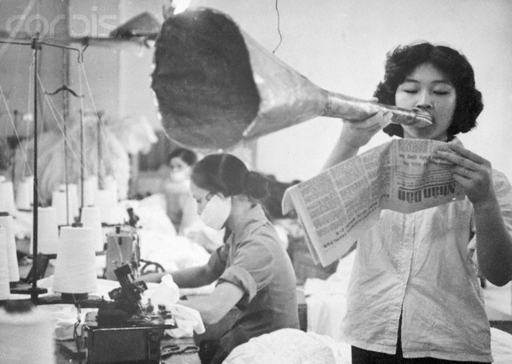
Media
Before newspapers were invented, town criers would go through city streets ringing a bell. They shouted the latest news as they were walking.

Slide 10
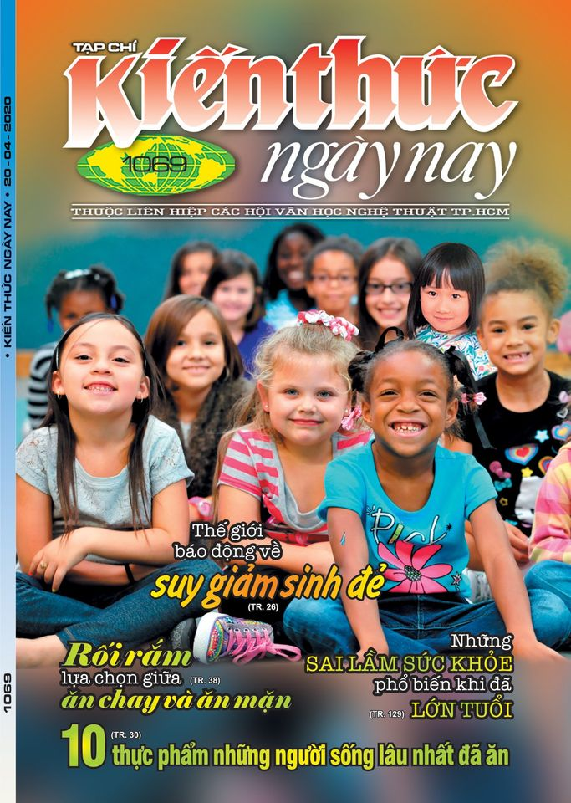

Media
B. In Viet Nam people love reading newspapers and magazines. The Kien Thuc Ngay Nay is one of the most popular magazines and is widely read by both teenagers and adults.

Slide 11
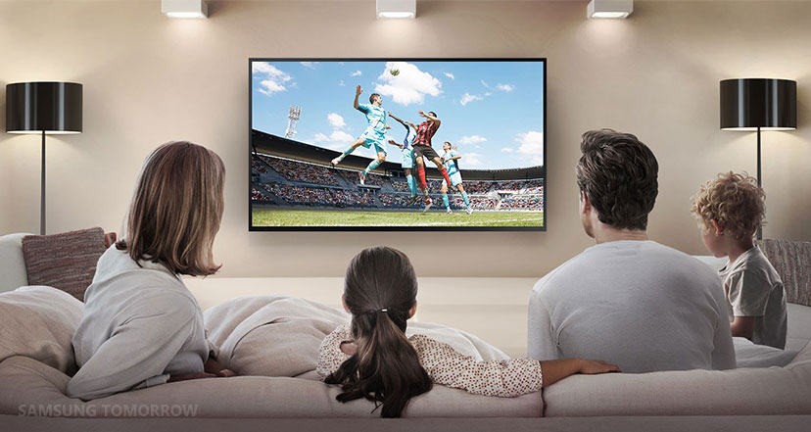
Media
C. Thanks to television people can get the latest information and enjoy interesting programs in an inexpensive and convenient way. Nowadays, viewers can watch a variety of local and international programs on different channels.

Slide 12
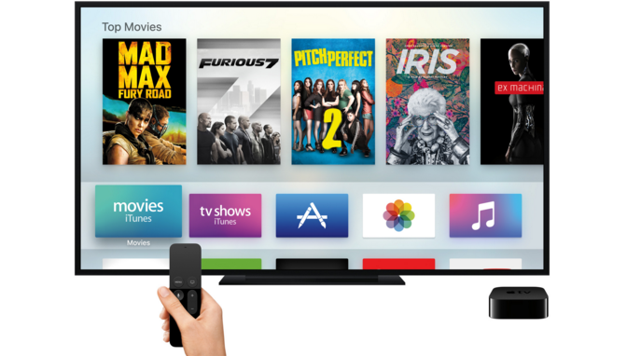
Media
  D. The next stage in the development of television is interactive TV. Viewers are able to ask questions about the show by using their remote controls.

Slide 13
Complete the table with passage letters
FACTS & EVENTS
Passage Letter
1. Remote controls are used to interact with TV
D
2. One of the most popular magazines
B
3. People of different ages like this magazine
B
4. Benefits of TV
C
5. People got the news from town criers
A
6. Interactive TV is available now
D

Slide 14
Answer the questions:
1. What was a town crier?
2. How popular is the Kien Thuc Ngay Nay?
3. What benefits does TV bring about to people’s life?
* Answer about you:
4. What kinds of magazines and newspapers do you read?
5. What’s your favorite type of media? Why?

Slide 15
Answer:
1. What was a town crier?
A town crier was a person who went through city streets ringing the bell and shouting the latest news.
2. How popular is the Kien Thuc Ngay Nay?
The Kien Thuc Ngay Nay is widely read by both teenagers and adults.
3. What benefits does TV bring about to people’s life?
Thanks to TV, people now can get the latest news and enjoy interesting programs and watch a variety of local and international programs on different channels.

Slide 16
Answer:
4. What kinds of magazines and newspapers do you read?
E.g. : I read the magazines and newspapers on science and social issues.
5. What’s your favorite type of media? Why?
E.g.: My favorite type of media is TV, because it can bring us a lot of varied news and interesting programs on every life and science.

Slide 17
Thank you!

